Slide 1
POTATO DISEASE CLASSIFICATION
~ ANISH SHARMA(219310042)
~AVINASH UPADHYAY(219310042)

Slide 2
INTRODUCTION
"Welcome to our project on potato disease classification using TensorFlow, NumPy, and Matplotlib. The aim of this project is to classify unhealthy potato plants based on the disease they have, such as early blight and late blight. We have created a website using HTML, CSS, and React JS that allows users to drop images and classify them based on their diseases. Our website uses a machine learning model trained on a dataset sourced from Kaggle and implemented using FastAPI. Through this project, we hope to contribute towards identifying and addressing potato diseases, ultimately leading to more sustainable and healthy crop production."

Slide 3
PROBLEM
Farmers who grow potatoes suffer from serious financial standpoint losses each year which cause several diseases that affect potato plants. The diseases Early Blight and Late Blight are the most frequent. Early blight is caused by fungus and late blight is caused by specific micro-organisms and if farmers detect this disease early and apply appropriate treatment then it can save a lot of waste and prevent economical loss. The treatments for early blight and late blight are a little different so it’s important that we accurately identify what kind of disease is there in that potato plant. So we are going to use Convolutional Neural Network – Deep Learning to diagnose plant diseases which will help farmers to detect disease in an early stage and can take diagnostic measures accordingly.

Slide 4
DATA COLLECTION
For this project we have used a ready-made dataset which we got from Kaggle which contains a numbers of images of an early blight, late blight and a healthy potato plant leaf which we will use to train our neural network

Slide 5
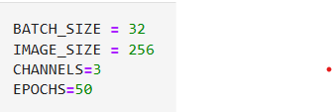
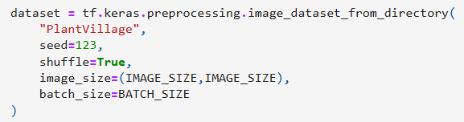
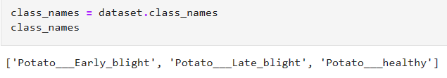
DATA PREPROCESSING
Setting all the constants:
Importing data into tensorflow data object:
Setting class names:

Slide 6
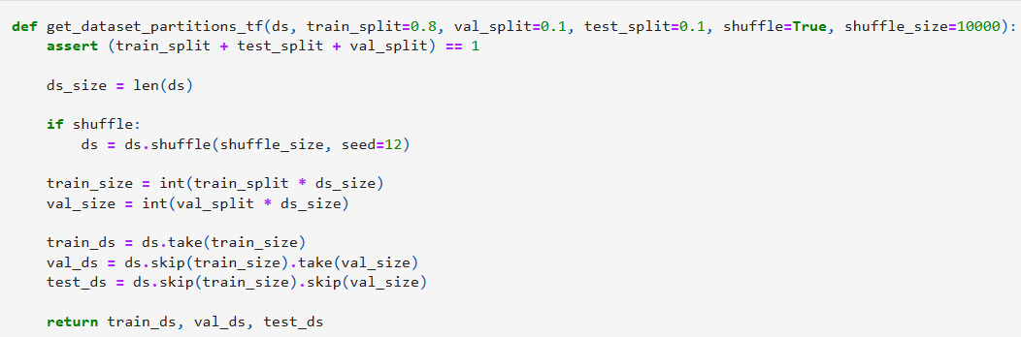

Bifurcating data into 3 subsets, namely:
Training: Dataset to be used while training
Validation: Dataset to be tested against while training
Test: Dataset to be tested against after we trained a model
Cache, Shuffle, and Prefetch the Dataset:

Slide 7
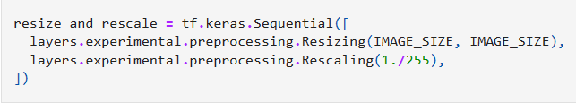
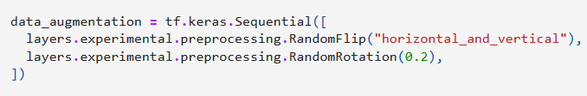

MODEL BUILDING
Creating a Layer for Resizing and Normalization:
Data Augmentation:
Applying Data Augmentation to Train Dataset:

Slide 8
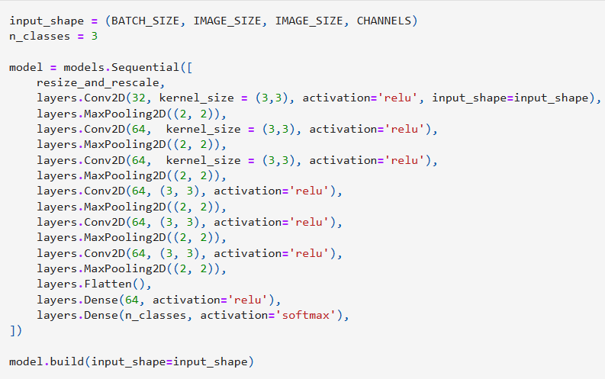
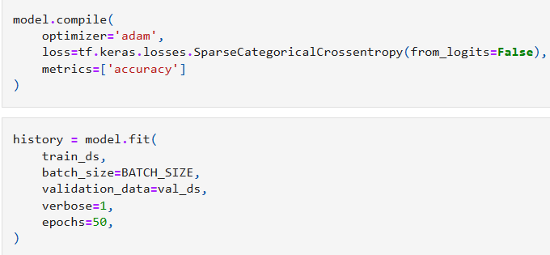
Building Model architecture:
We used a CNN coupled with softmax activation in the ouput layer
Compiling the Model:
We used Adam optimizer, Sparse categorical cross entropy for losses and accuracy as a metric

Slide 9
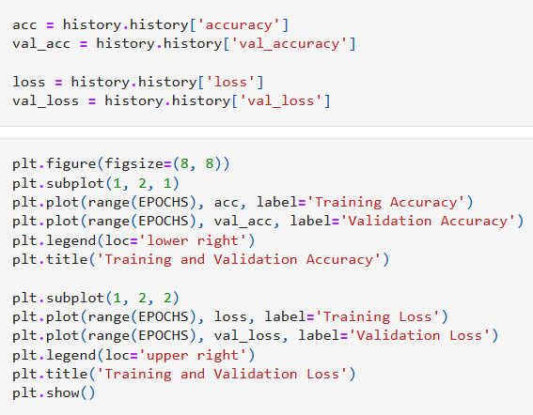
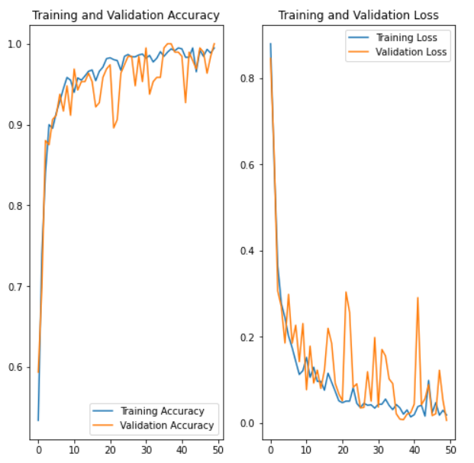
RESULTS AND EVALUATION
Plotting accuracy and loss curves:
loss, accuracy, val loss etc are a python list containing values of loss, accuracy etc at the end of each epoch

Slide 10
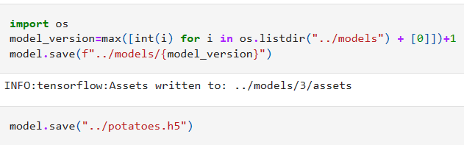
SAVING THE MODEL
We append the model to the list of models as a new version

Slide 11
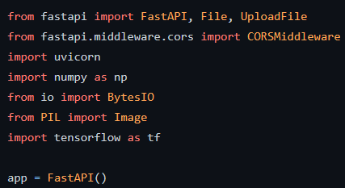
WEB DEPLOYMENT
Installing FastApi, Uvicorn and some other libraries
Creating a FastApi application and importing the model

Slide 12
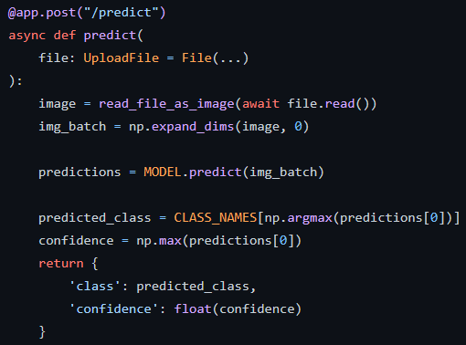

Defining the FastApi endpoint
Running the FastApi application

Slide 13
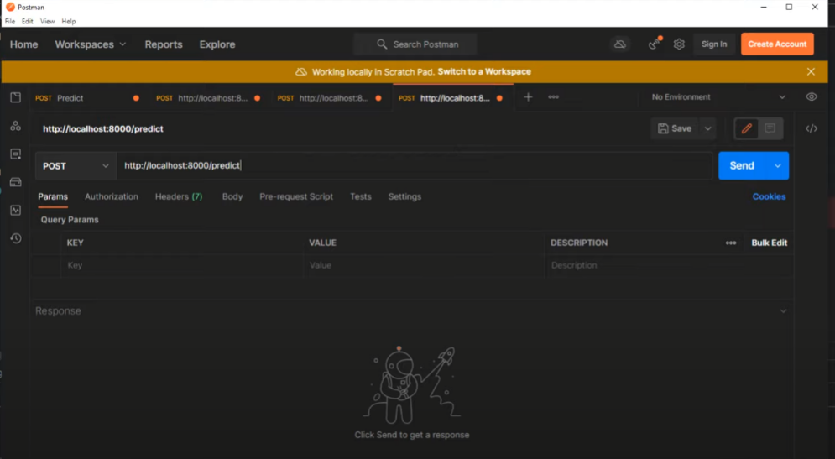
Testing the Endpoint which returns a JSON file with predictions

Slide 14
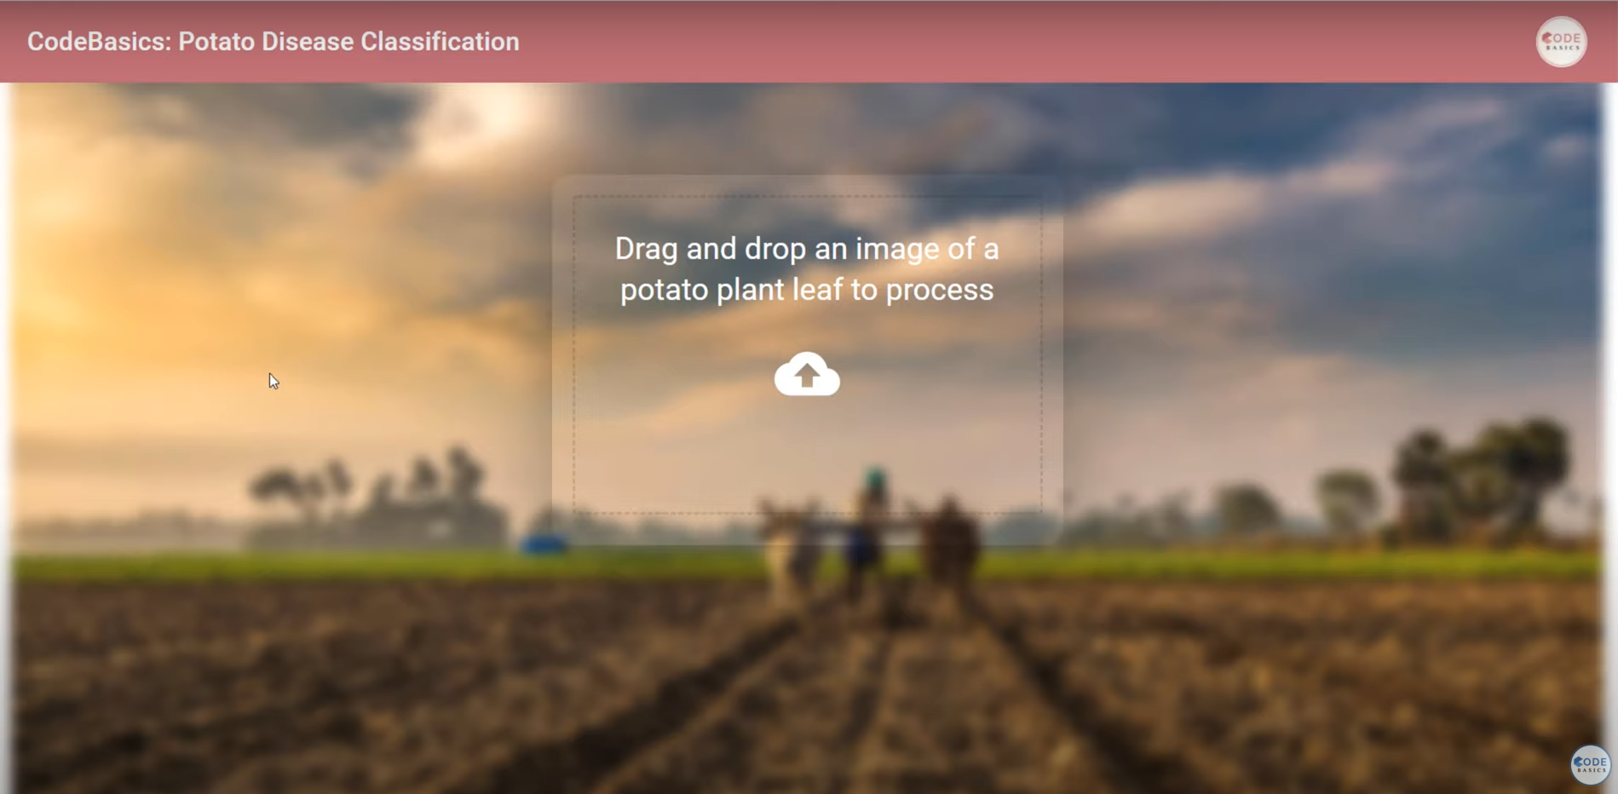
Creating Website
Created a simple webpage using React, Html and CSS with drop and drag functionality to test the model

Slide 15
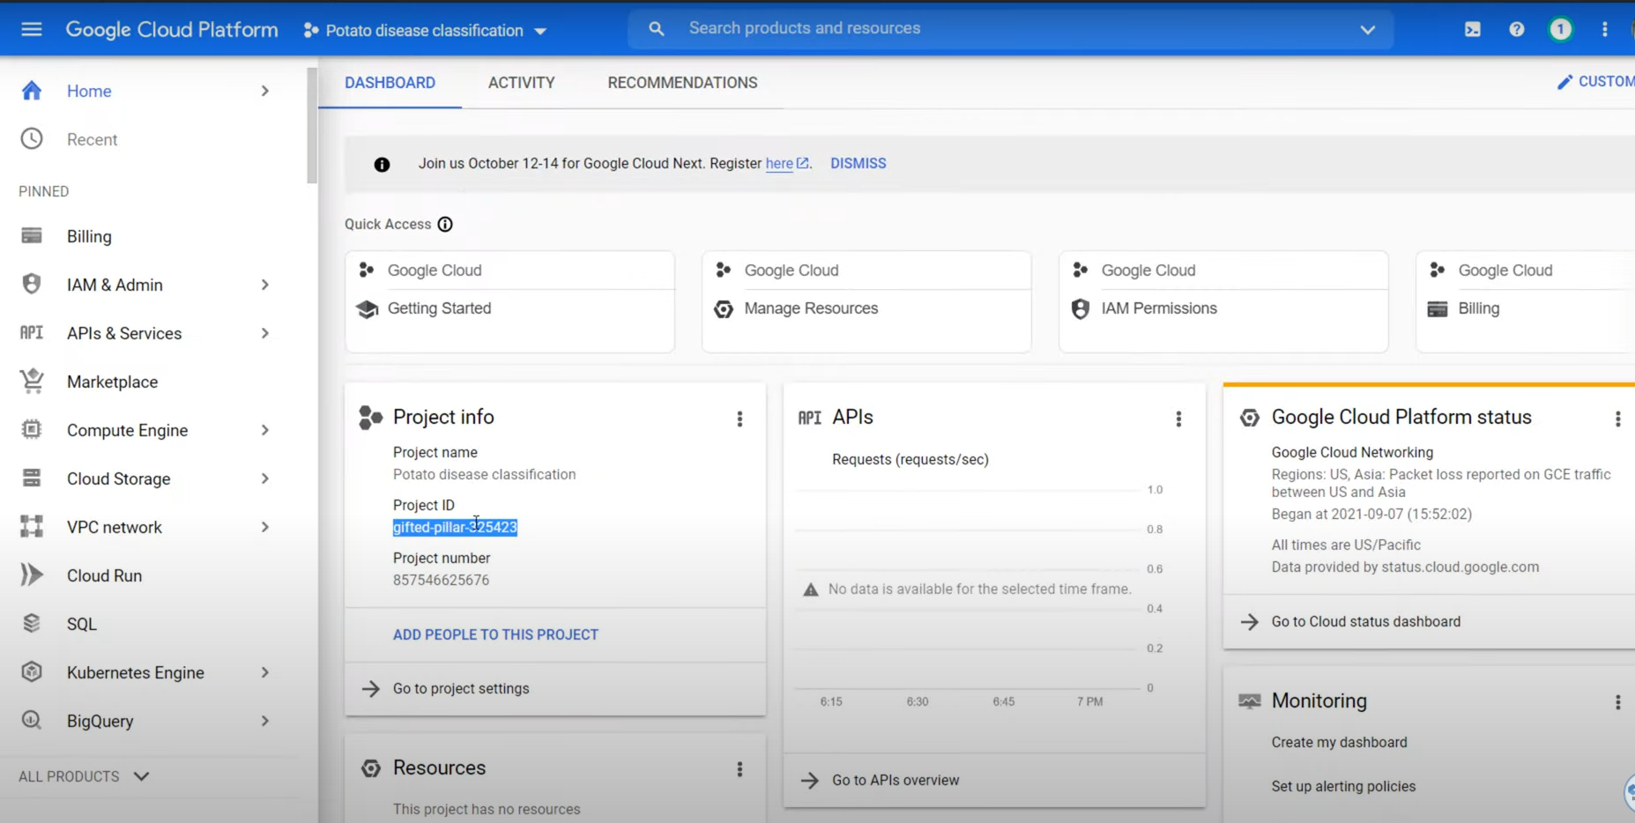
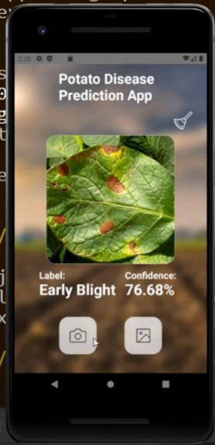
FUTURE PROSPECTS
We will deploy the model to google cloud using GCP and create a mobile application using react-native

Slide 16
CONCLUSION
The web-based application we made will enable farmers and researchers to classify unhealthy potato plants accurately. This will aid in identifying diseases early and applying appropriate treatments, leading to a decrease in economic loss. The application's user-friendly interface and ease of use will allow it to be used by a broad range of individuals in the agricultural sector, making it a valuable tool in potato farming and research.

